Slide 1
LOEX 2022
YPSILANTI, MI
PERCEIVED AUTHORITY, REAL CONSEQUENCES: RESEARCH-INFORMED PRACTICES TO TEACHING STUDENTS ABOUT AUTHORITY & MISINFORMATION

Slide 2
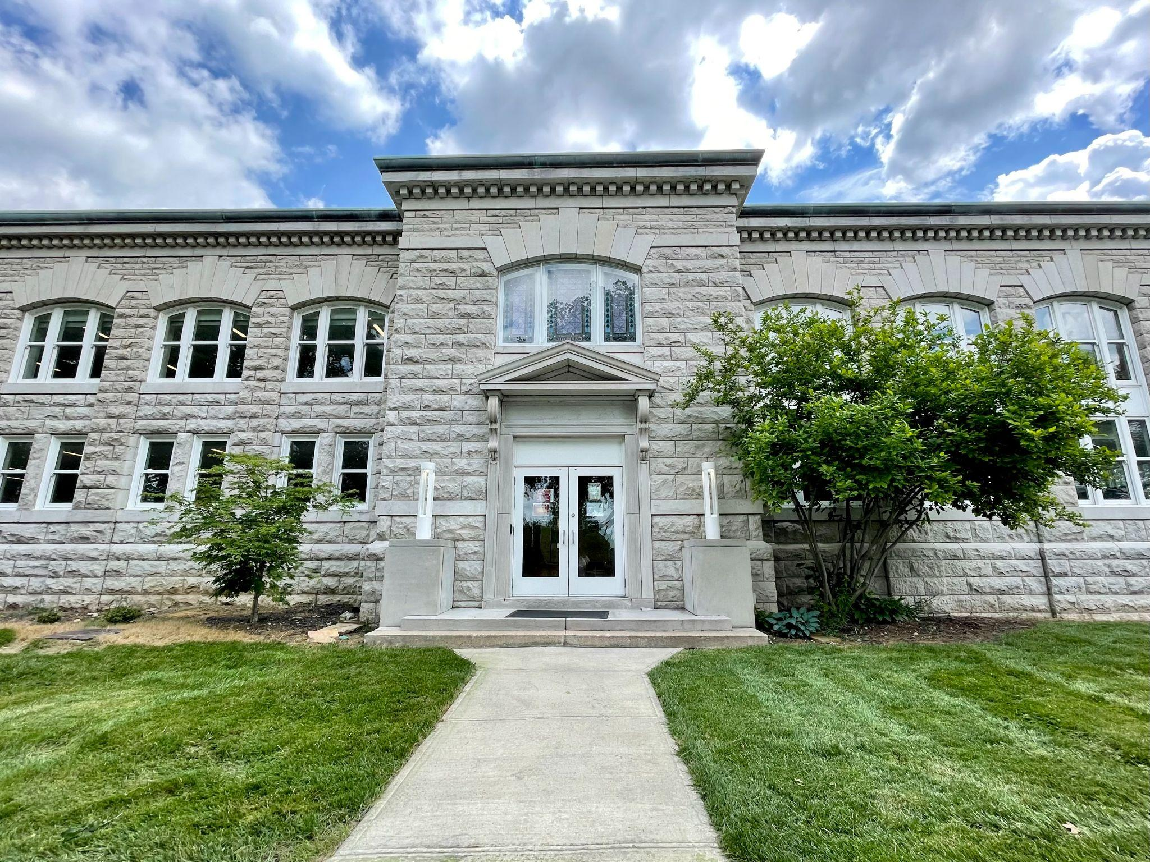
Camille Abdeljawad
(she/her/hers)
Instruction & Outreach Librarian, Assistant Professor
Park University // Kansas City, MO
camille.abdeljawad@park.edu

Slide 3
INITIAL INTEREST + RESEARCH FOCUS
Information Literacy for Lifelong Success
How do my students understand authority?
How do students apply their information literacy to their everyday lives?
How do we teach the ALA Frame “Authority is contextual and constructed”?
What previous research has been done?
Notes:
"the ability to know when there is a need for information, to be able to identify, locate, evaluate, and effectively use that information for the issue or problem at hand"
While I teach all the frames, Authority is contextual and constructed has always been challenging to me
I’ve utilized CRAAAP, SIFT, IF I APPLY, etc to teach without really being satisfied
I recognized a gap in understanding that I held
I wanted to better understand how students understand authority – I know that authority is contextual and constructed, but do they?
How do students situate this in their everyday life?
How can I better teach this frame?

Slide 4
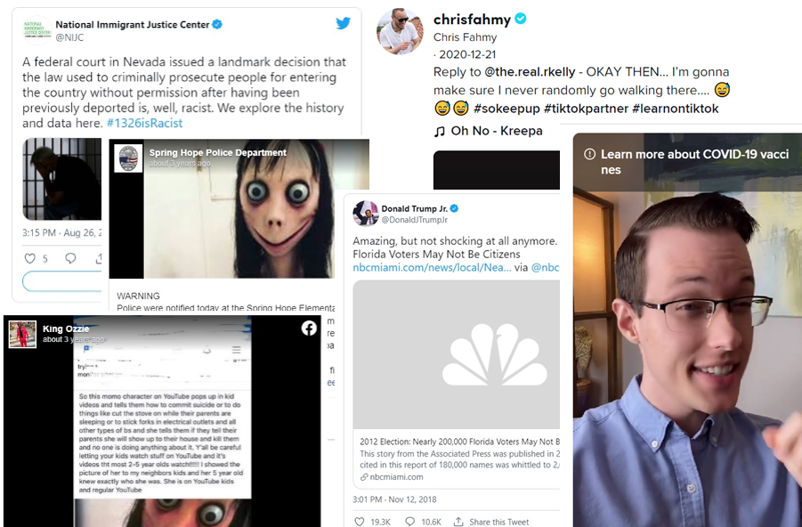
RESEARCH STUDY
Survey design & administration

Slide 5
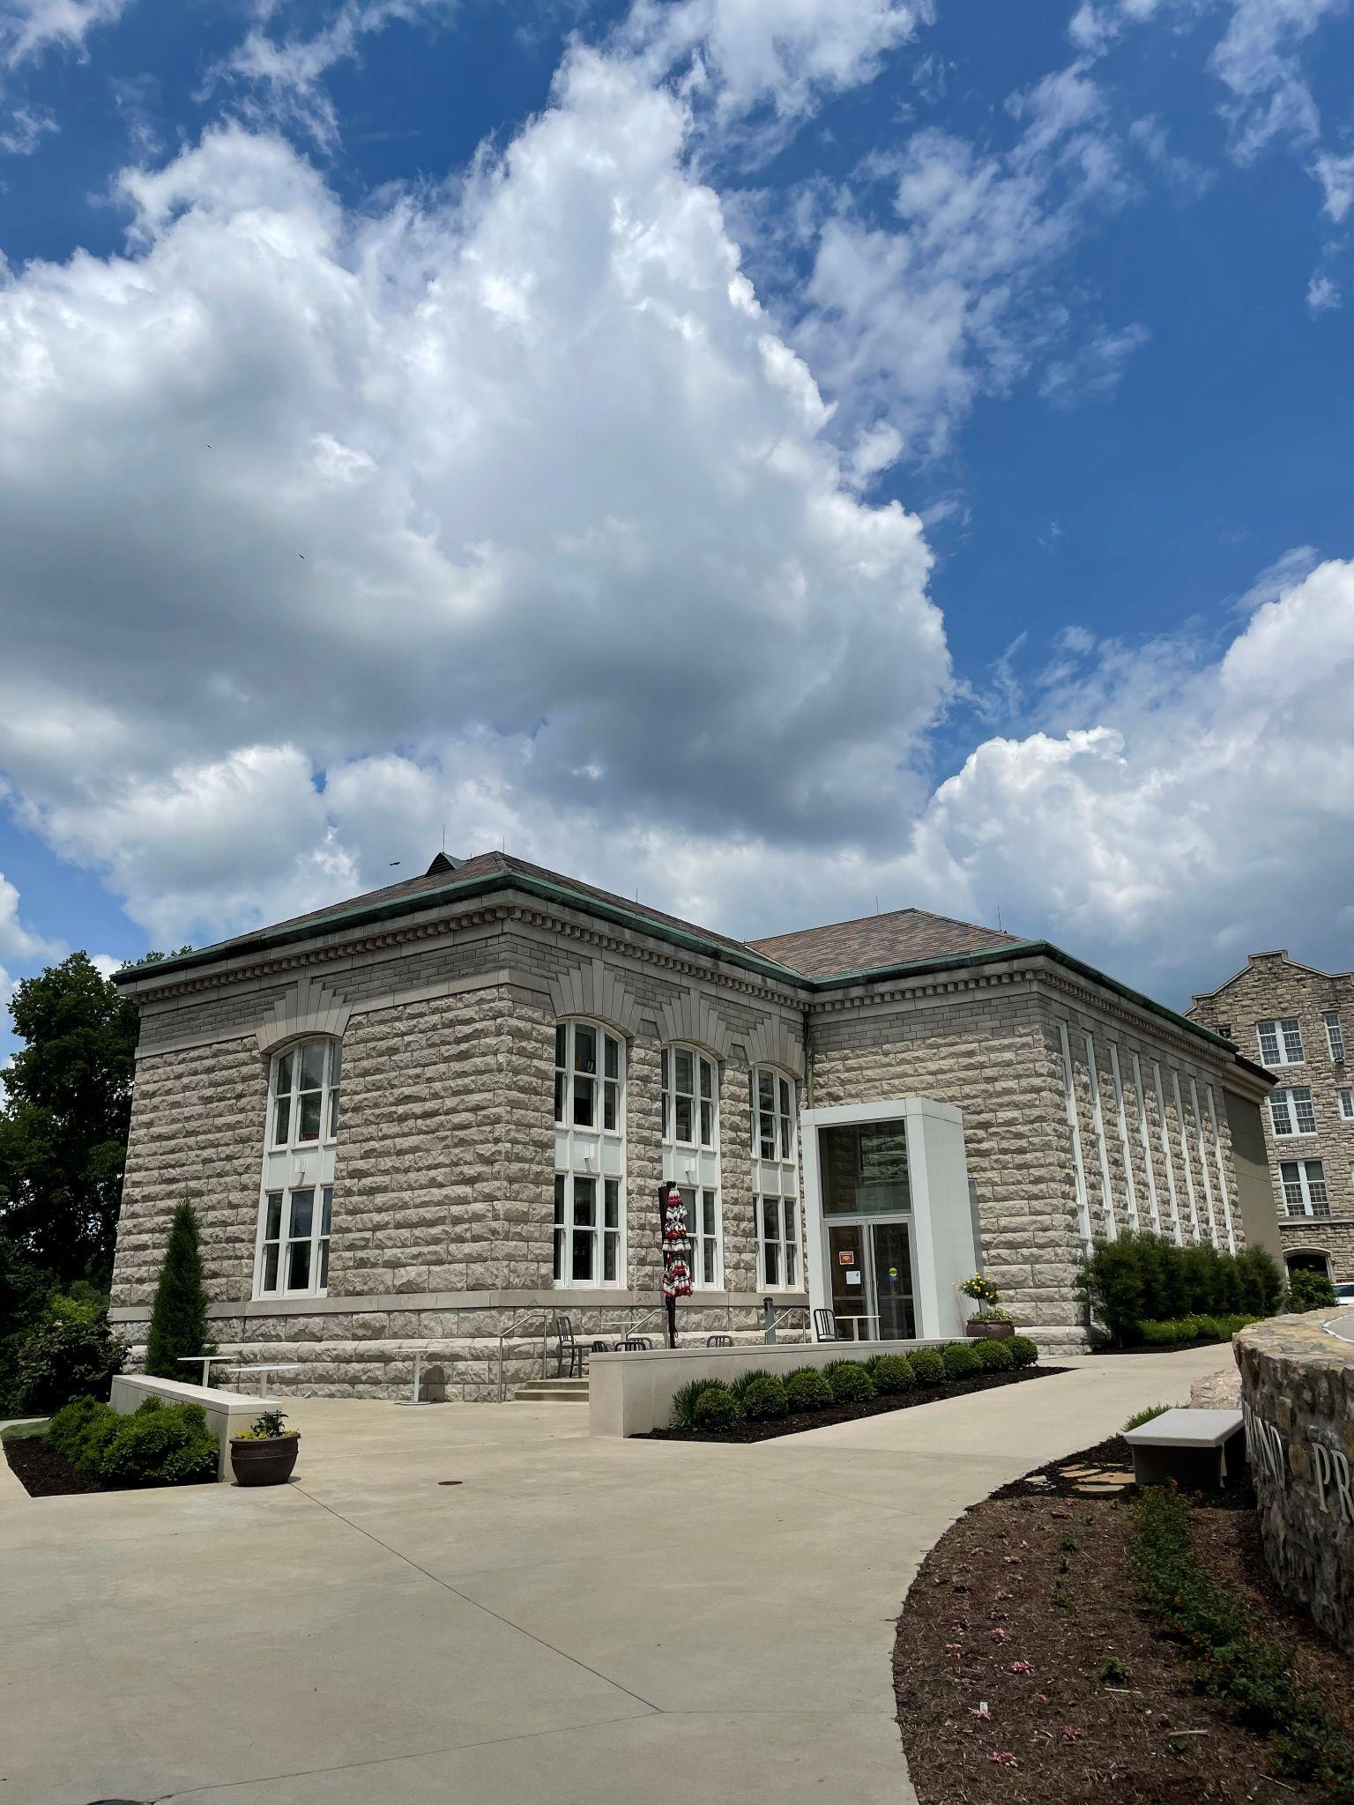
PARK UNIVERSITY
Mid-size, private, Liberal Arts University (10k) in
North Kansas City, MO
58.7% of student body is military-affiliated
Average age of undergraduates is 30 y/o
“Transfer-friendly” reputation

Slide 6
RESEARCH STUDY
6 Evaluation Activities
2 from Twitter, Facebook, and TikTok
Authored by a range of perceived authorities
Half contained misinformation
321 First-Time, Full-Time Freshman
20.25% response rate
Each evaluation activity asked three questions…
After viewing this post, how likely are you to share this information with anyone via text, email, or social media?
Please explain your reasoning for the likelihood of you sharing this information (1-2 sentences).
How confident are you that this information is accurate?
Full data and research findings will be published in the coming months.

Slide 7
THEMATIC FINDINGS
Inherent trust in traditional authority figures
Such as police departments and scientists
An adherence to markers of credibility
Perceived versus actual
Students mentioned things like being verified on the platform, referring to links in caption, and credentials listed in screen name
Lack of perceived social responsibility for information shared online
Notes:
"the ability to know when there is a need for information, to be able to identify, locate, evaluate, and effectively use that information for the issue or problem at hand"
While I teach all the frames, Authority is contextual and constructed has always been challenging to me
I’ve utilized CRAAAP, SIFT, IF I APPLY, etc to teach without really being satisfied
I recognized a gap in understanding that I held
I wanted to better understand how students understand authority – I know that authority is contextual and constructed, but do they?
How do students situate this in their everyday life?
How can I better teach this frame?

Slide 8
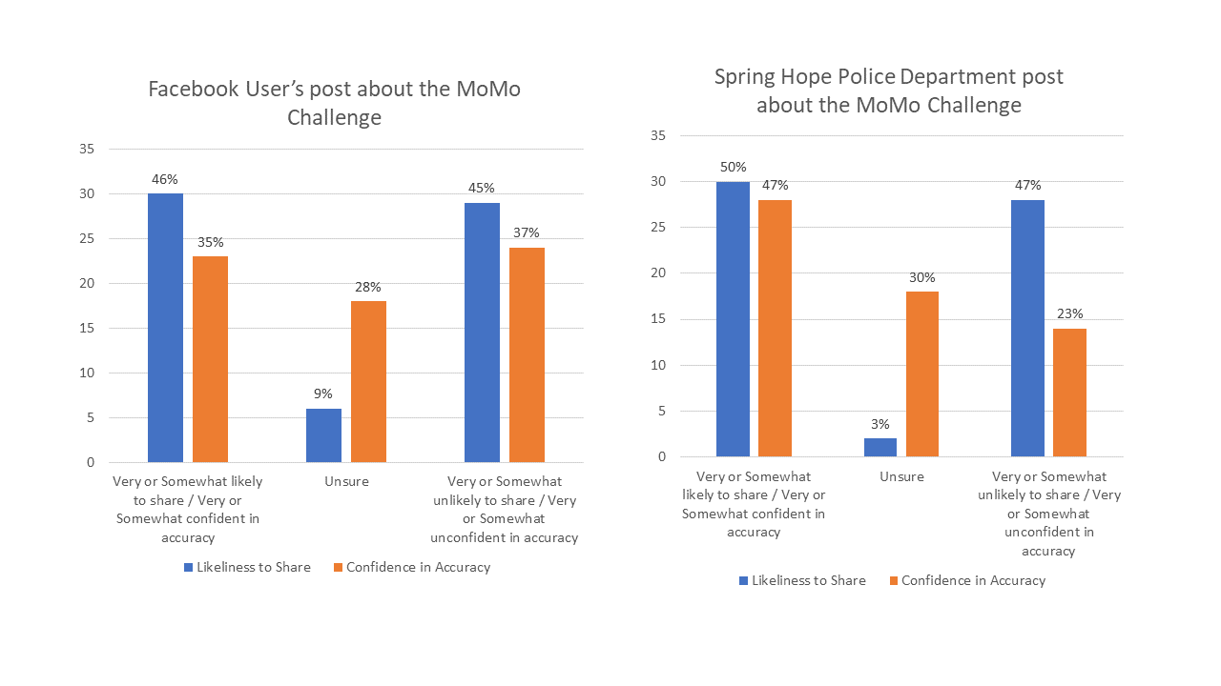
Comparing two posts regarding internet hoax the “MoMo Challenge”

Slide 9
Findings
15%
68%
Students who showed critical analysis in reasoning for sharing or not sharing posts
Students who showed an emotional response for sharing or not sharing posts

Slide 10
COMPARING QUALITATIVE DATA
Critical Response
Emotional Response
“This makes me think that this source is going to be biased and if it’s biased then it’s probably not super accurate so I wouldn’t share this information.”
“I would share this information via text because I have older siblings that have kids and I wouldn't want this to happen to them.”

Slide 11
IMPLICATIONS FOR TEACHING
INFORMATION LITERACY

Slide 12
SOCIAL RESPONSIBILITY
“While it isn't from a reliable source, I doubt there would be intent to lie about something like this.” – Qualitative Response to a post on the “MoMo Challenge”
Reflection
What do each of the elements of this game represent?
What can we do to disrupt this cycle?
What is our obligation to disrupt this?
Notes:
An interesting observation I made from the data collection period was the way that students responded to the content presented. Several students remarked that they would share posts “Because its [sic] funny. For the meme” or “I think it’s interesting and would send to my friends but would know it may not be true”.
Based on the data I collected, including both the qualitative data and quantitative data, I noticed that there seems to be a disconnect for many students between the posts that they share and the ramification those posts have on the greater social media landscape.
To this, I wonder: is the perceived risk of not sharing the potentially important information worse than the chance of sharing false information? How can we teach students about their own social responsibility to share correct information? How do we illustrate the way information is misconstrued, warped, and click-baited on social media?
One question I still wrestle with is: How do we convince them that this something worth caring about? How do we empower students with their social responsibility, rather than making it another checklist they have to remember?

Slide 13
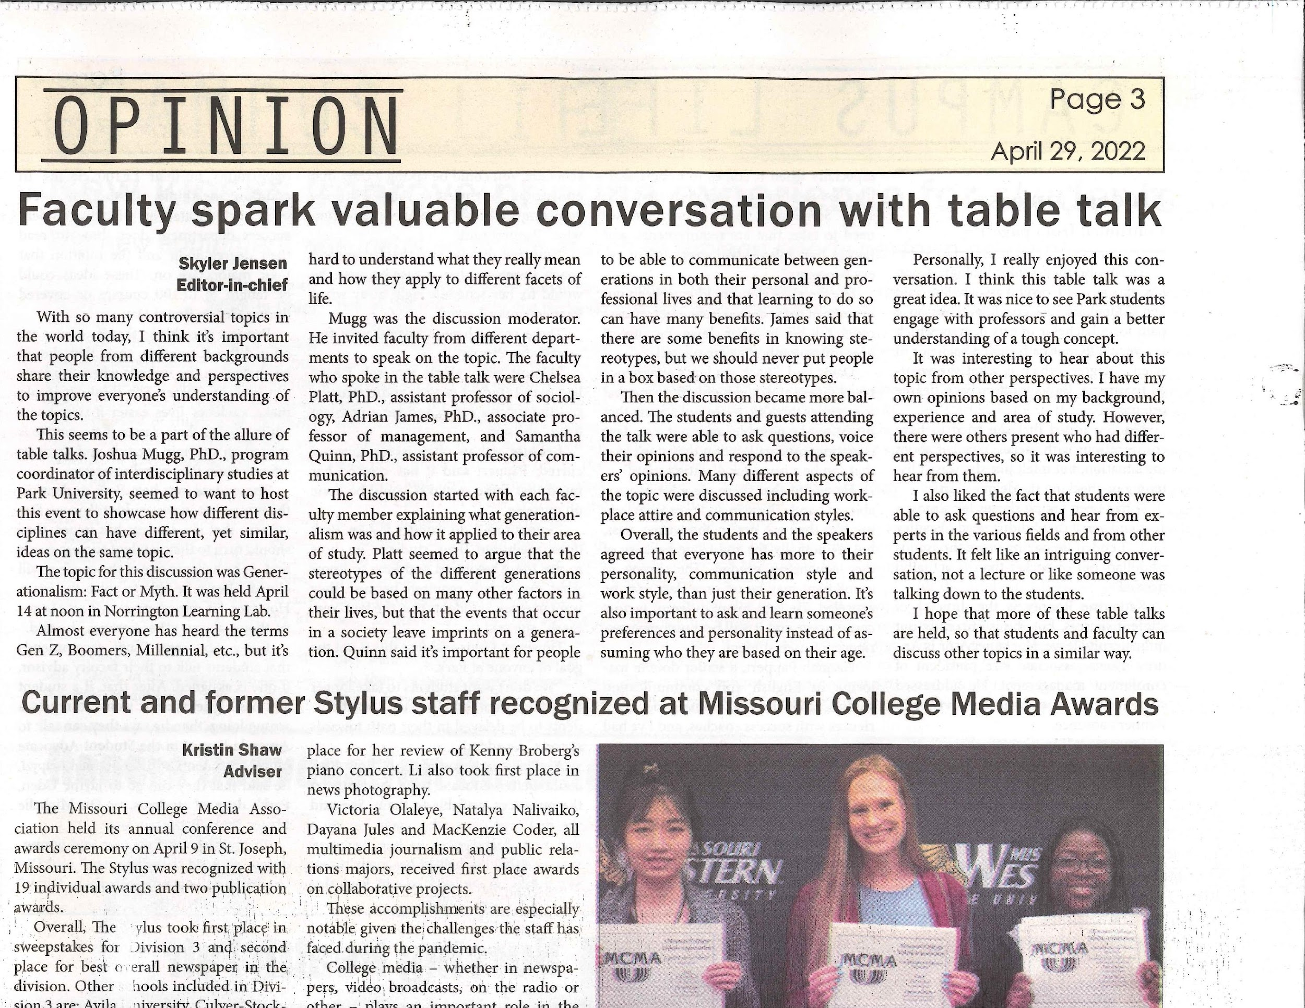
INFORMATION LITERACY OUTSIDE THE CLASSROOM
Bridge the gap…
Notes:
While only 15% showed critical analysis, I do not, however, think this means that students do not have critical thinking skills; rather, even though Generation Z are “digital natives” (Mohr, 2017, p. 86), they struggle to contextualize their critical thinking skills in the changing, dynamic, and relatively unmonitored landscape of social media
. Similarly, several students remarked in their qualitative responses that they utilize social media for fun or to connect with family in friends rather than to seek out news and information. This particular remark was applied to TikTok©, a video sharing platform. If students approach social media platforms as a place to share ideas, be creative, and find funny things to send to their friends, it is no wonder they often do not critically examine at the posts they share, to the same caliber that they might exam an internet article like they have been taught in class.
For instruction librarians, it is critical that we help bridge the gap between analyzing web pages and scholarly articles to analyzing social media posts and every other piece of information students come across.
I reject the notion that this means more instruction sessions. After all, students need frequent and repeated exposure to these ideas which is not always possible within the constraints of one-shot presentations.

Slide 14
In the past week, where did you learn about current events or news? Select all that apply.

Slide 15
INFORMATION LITERACY OUTSIDE THE CLASSROOM
Bridge the gap…
Create opportunities for exposure
Partner with other student organizations, clubs, depts
Post tips to being a critical consumer of information on your library’s website and social media platforms.
“Ask a Librarian” sessions Live on Instagram or TikTok
Notes:
While only 15% showed critical analysis, I do not, however, think this means that students do not have critical thinking skills; rather, even though Generation Z are “digital natives” (Mohr, 2017, p. 86), they struggle to contextualize their critical thinking skills in the changing, dynamic, and relatively unmonitored landscape of social media
. Similarly, several students remarked in their qualitative responses that they utilize social media for fun or to connect with family in friends rather than to seek out news and information. This particular remark was applied to TikTok©, a video sharing platform. If students approach social media platforms as a place to share ideas, be creative, and find funny things to send to their friends, it is no wonder they often do not critically examine at the posts they share, to the same caliber that they might examen an internet article like they have been taught in class.
For instruction librarians, it is critical that we help bridge the gap between analyzing web pages and scholarly articles to analyzing social media posts and every other piece of information students come across.
I reject the notion that this means more instruction sessions. After all, students need frequent and repeated exposure to these ideas which is not always possible within the constraints of one-shot presentations.

Slide 16
WILL THIS MEET MY INFORMATION NEED?
CRAAP, IF I APPLY, etc
Sometimes, the approach we take to teaching these lacks nuance.
What headspace do students need to be in to use this?
Notes:
Nuance is the name of the game when it comes to authority!
Instead of asking our students whether using TikTok or Instagram to get their news is good or bad, engage them in a discussion of whether a TikTok on COVID-19 vaccines that was created by a medical doctor and cites publications from the Center for Disease Control & Prevention will meet the information need they have.
When we dismiss sources as good or bad, we neglect to meet students where they are at – on social media and immersed in the digital world. Instead of labeling sources as all good or all bad, let’s teach students practical skills to evaluate whether a piece of information will meet their information need in the real world.
Lateral reading
If students could remember to simply pause before deciding to share or not share, paired with their repeated exposure to evaluating authority and their increased social responsibility, they could radically change their social media experience.

Slide 18
WILL THIS MEET MY INFORMATION NEED?
CRAAP, IF I APPLY, etc
Sometimes, the approach we take to teaching these lacks nuance.
What headspace do students need to be in to use this?
Pause…
Empower students to disrupt cycles by pressing pause.
Notes:
Nuance is the name of the game when it comes to authority!
Instead of asking our students whether using TikTok or Instagram to get their news is good or bad, engage them in a discussion of whether a TikTok on COVID-19 vaccines that was created by a medical doctor and cites publications from the Center for Disease Control & Prevention will meet the information need they have.
When we dismiss sources as good or bad, we neglect to meet students where they are at – on social media and immersed in the digital world. Instead of labeling sources as all good or all bad, let’s teach students practical skills to evaluate whether a piece of information will meet their information need in the real world.
Lateral reading
If students could remember to simply pause before deciding to share or not share, paired with their repeated exposure to evaluating authority and their increased social responsibility, they could radically change their social media experience.

Slide 19
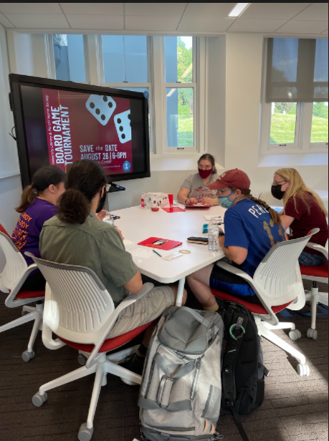
TAKEAWAYS
Empower students to own their social responsibility
Explore opportunities for exposure to these ideas OUTSIDE the classroom
Encourage students to PAUSE before sharing information to assess whether it will meet their information need

Slide 20
QUESTIONS & FEEDBACK
BEST PRACTICES + TIPS FROM THE AUDIENCE

Slide 21
Poll Everywhere Audience Responses:
Asking students what they are expert in and how they became an expert in that skill/topic, asking them to share a resource
I introduce authority when I talk about social justice concepts involved with cataloging and search terms.
"cinnamon roll" example - if I want to make cinnamon rolls, where do I look for a recipe? Scholarly journal NOT necessary/most authority on the topic. Mom, recipe video/website, or cookbook are best/good authority for this information need.
Evaluate different kinds of search results we get if we search for same topic but using different terms, based on different perspectives. Example, results on GMOs for search terms that new parents vs farmers vs environmental activists might use.
I don't use craap or sift, I use the 4 elements of an APA citation - author, date, title/content, and source. I have them find those (they need them for the citation) AND use those to evaluate the quality of the item and it's usefulness to them.
I work with health care and social work, so we have to balance traditional research sources with the lived experiences of clients. We do a lot of discussions, more focused on teasing out the value of different perspectives.
Activity which requires them to Google the author and site before evaluating the source itself (based on SIFT method)
Use journalism photos to discuss elements contributing to authority
I've used social media examples around nutrition and wellness.

Slide 22
Poll Everywhere Audience Responses:
Challenge the idea that only published "professionals" with lots of citations can be cited or trusted
Look at an author's qualifications/institutional affiliation
We talk about about evaluating the "content" independent of the "container" (book, podcast, instagram post, etc.)
It depends on what I'm going for. SIFT/lateral reading for everyday contexts, but a more rhetorical approach for academic contexts. I also like to balance "authority" against "process".
An activity I like, comparing a blog post and scholarly article on a similar topic and by the same author. Good for getting at the nuance of authority.
Connect the "scholarly" and lived experience as different types of expertise.
SIFT framework
Compare original research, newspaper article about the research, and tweet about same topic. Talk about when each would be most useful.
Everyday scenarios and cat memes
ask students what makes someone an "expert" and then discuss what are some barriers to becoming an expert and are there excluded/included voices because of those barriers
Have them explore their own expertise.

Slide 23
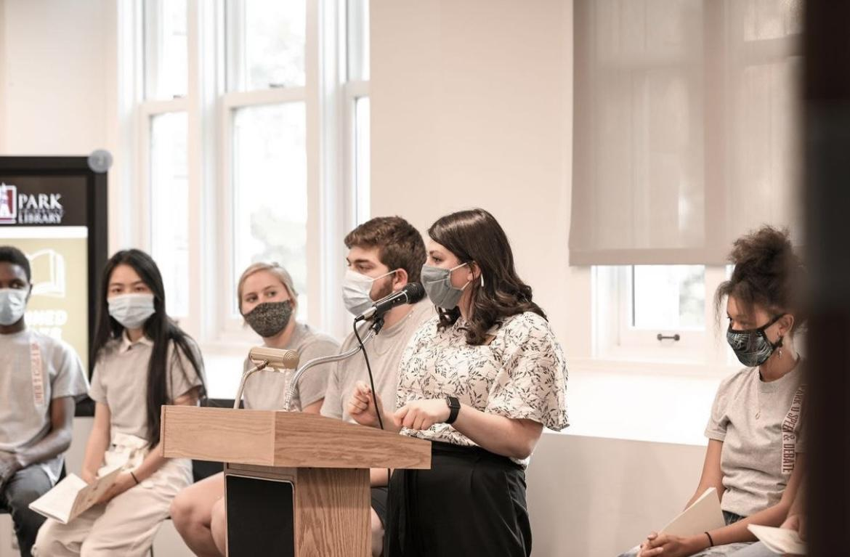
THANK YOU.
Camille Abdeljawad
Park University
E: camille.abdeljawad@park.edu
P: 816-584-6282
Reach out with questions or if you’re interested in collaborating on further projects!

