Slide 1
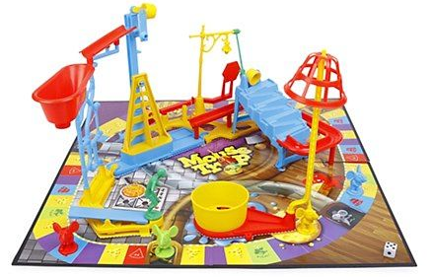
You Can't Catch Fruit Flies in a Mousetrap
LOEX 2019
Pest Control in the 21st Century Library
Teaching Contextual Evaluation of Information
Gary Arave
Indiana University

Slide 2
Who are we?
imagine
my face here
Christina Sheley Gary Arave Minjeong Kang

Slide 3
IL Grants at IU
Started in 2011
Pair faculty with librarians to (re)design courses in order to build information literacy into the structure and content of the course.

Slide 4
The Course
400-level Public Relations class
Service learning model
Both secondary & primary research

Slide 5
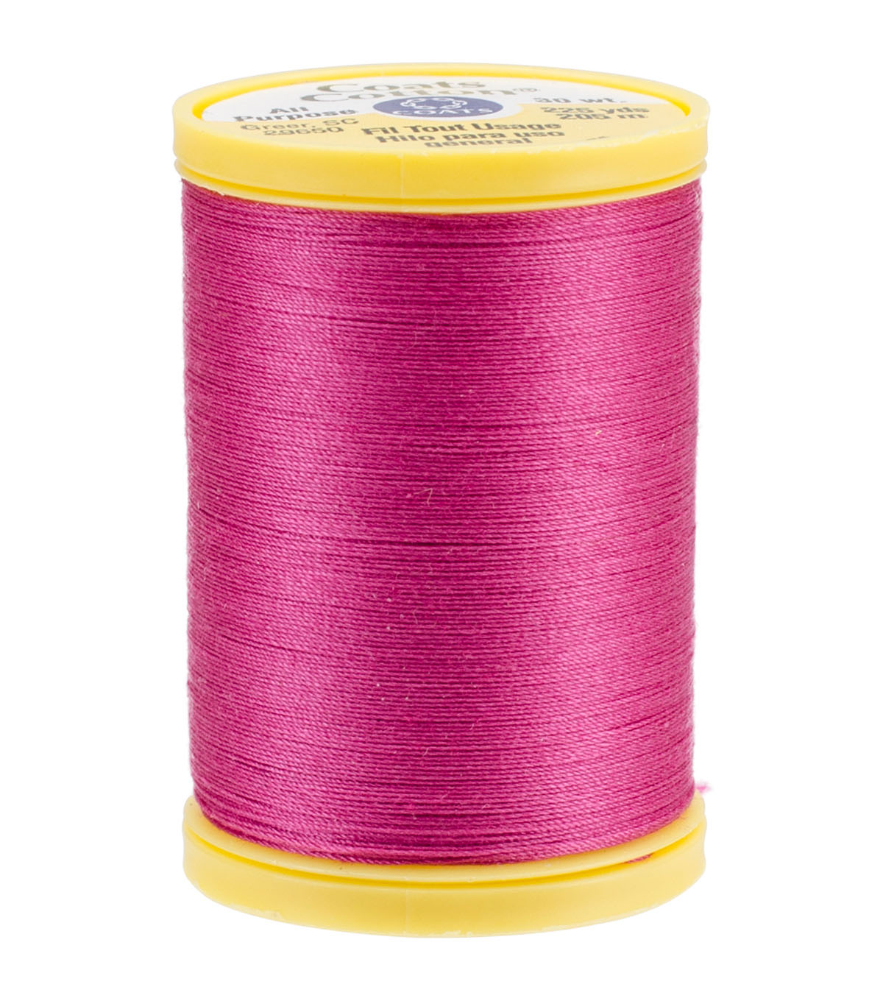
What's the common thread?
Information Literacy
Financial Literacy
Digital Literacy
Source Literacy
Data Literacy
Sensemaking
(Bergson-Michelson, T. & Seroff, J. (2016). What Makes
a Literacy? Knowledge Quest, 44(5), 6–7.

Slide 6
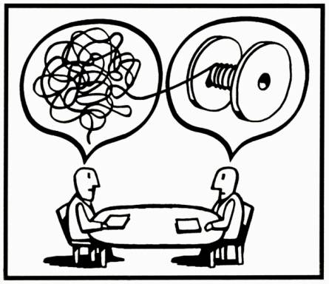
Sensemaking
We make sense of our world through
categories and context.
Categories reduce cognitive load
typicality novelty
Context helps us decide what's appropriate
Both depend on experience!
Illustration by Igor Kopelnitzsky
Notes:
Bergson-Michelson and Seroff (2016) assert that all of these boil down to sense-making, which “includes developing enough background knowledge to interpret and make judgments; it allows us to notice patterns and discrepancies, so we can make connections among diverse ideas” (p. 6).

Slide 7
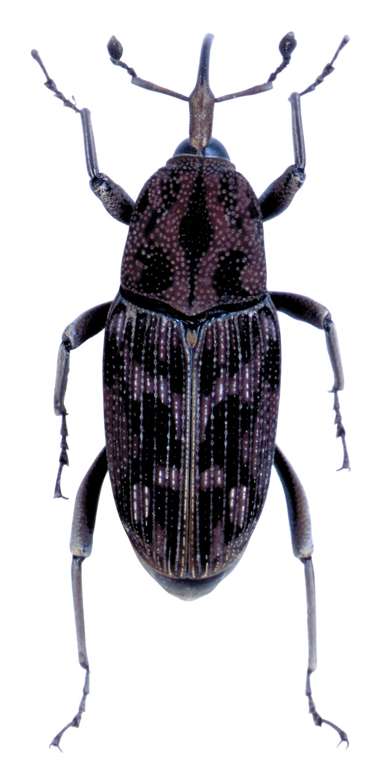
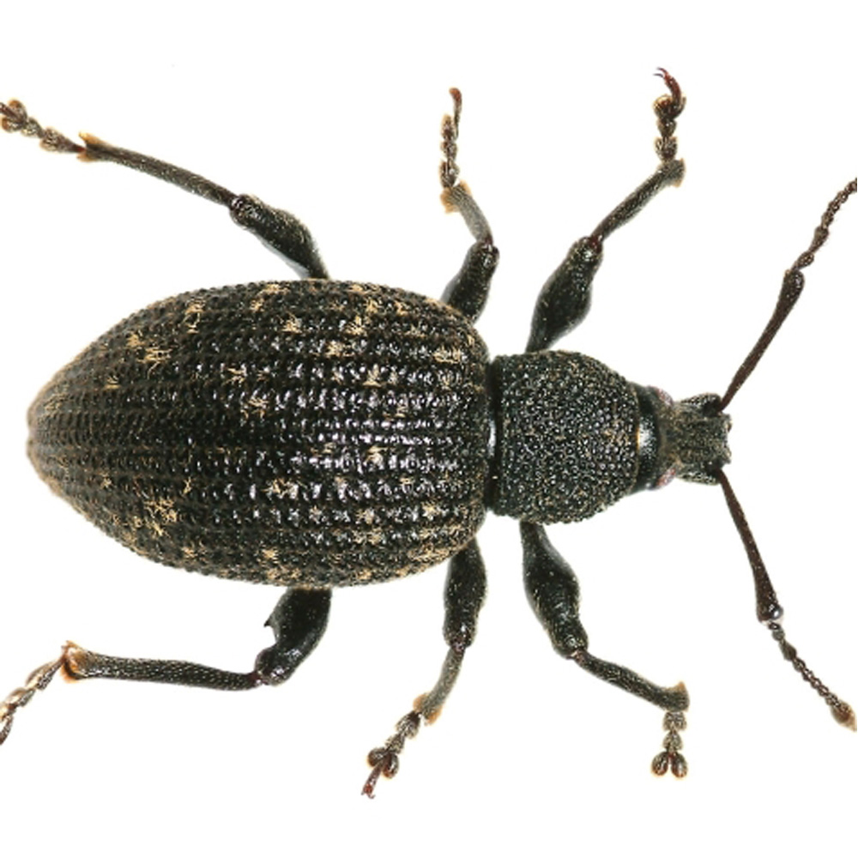
Information sources are like bugs
(obviously)
Novices
Experts
May have broad categories only
Have more categories
May not know whether what they're looking at falls into a category
Can identify members of a category
May lack the vocabulary to describe differences even if they can see them
Have specific vocabulary to describe their domain

Slide 8
What's the problem?
"My students can't research."
"My students can't cite."
"My students can't write."

Slide 9
What are the symptoms?
Corporate Social Responsibility is the opportunity for businesses to connect with the community. With this responsibility comes the commitment to maintain ethical behavior and contribute to economic development for improvement of quality of life within the business and the society (Holme).
Holme, Richard, and Phil Watts. (1999). "Corporate social responsibility."
http://megamindservices.in/pdfs/CORPORATE%20SOCIAL%20RESPONSIBILITY.pdf

Slide 10
What are the symptoms?
According to the New york Times, "at colleges, the marketers are everywhere."
“We think of (college students) as a bridge. They will have
influence back home and influence going forward.”

Slide 11
What are the symptoms?
Arneal found the highest level of volunteer involvement came when an organization or company offered to match what was
raised or donated (Arneal, 2015). Schulte found more than
three-fourths of Millennials agreed to donate time when they
could use specialized skills (Schulte, 2015)

Slide 12
What are the symptoms?
In Bedford, Protestant is the dominant religion - a religion that stems from Christianity (City-Data). While many might see this as an inhibition, one of Christianity’s core values is love (Access-Jesus.com), meaning that these people continuously preach love.

Slide 13
What are the symptoms?
 | St. Paul, MN | Paoli, IN
Population | 307,059 | 3,626
Median Income | $61,665 | $42,529
% population with Master's or Doctorate | 36% | 10%
% White | 55% | 97%
% Black | 17% | .47%
% Hispanic | 10% | 1%
% Asian | 17% | .44%
One case study looked at about metropolitans in the St. Paul area took real pride in their intricate bike paths and brought people together (Krizek, 2007). Families could go to the park and use the bike path at the same time.

Slide 14
What are the symptoms?
Alfred North Whitehead once said, “civilization advances by extending the number of operations we can perform without thinking about them” (Henderson). By listening to others and allowing them to shape our opinions, we as humans, save time.
Henderson, Rob. “The Science Behind Why People Follow the Crowd.” Psychology Today, Sussex Publishers, 24 May 2017.

Slide 15
What are the symptoms?
Using data from the 1996 to 1997 National Organizations Survey, a national sample of for-profit business organizations, this article tests eight hypotheses derived from the value-in-diversity thesis. The results support seven of these hypotheses: racial diversity is associated with increased sales revenue, more customers, greater market share, and greater relative profits.
“racial diversity is associated with increased sales revenue, more customers, greater market share, and greater relative profits” (Herring).
Herring, Cedric. “Does Diversity Pay?: Race, Gender, and the Business Case for Diversity.” American Sociological Review, vol. 74, no. 2, 2009, pp. 208–224. Sage Journals.

Slide 16
What's the problem?
Students don't know what they're looking at
("everything's a website" [Badke, 2012])
Students don't know what to look for
Students don't know they have a voice in an academic context
Badke, W. (2012). When everything is a website. Online, 36(5), 48–50.

Slide 17
The Goal
 | St. Paul, MN | Paoli, IN
Population | 307,059 | 3,626
Median Income | $61,665 | $42,529
% population with Master's or Doctorate | 36% | 10%
% White | 55% | 97%
% Black | 17% | .47%
% Hispanic | 10% | 1%
% Asian | 17% | .44%
Give students tools to evaluate the match between the context in which information was created and the context to which they are applying it
Address the idea of qualified use

Slide 18
The CRAAP test is like Paul Hollywood
(obviously)

Slide 19
What's the problem?
The CRAAP test, the ACRL Framework and many
other tools are too much of a black box.

Slide 20
What's the problem?
Citation itself need to be better contextualized.
"current culture of plagiarism hysteria"
(Jamieson & Howard, 2013, p. 113).

Slide 21
Pedagogical Approach
time

Slide 22
Pedagogical Approach
CLASS
ROOM

Slide 23
Pedagogical Approach

Slide 24
Pedagogical Approach

Slide 25
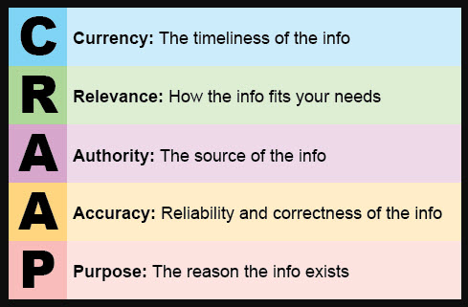
Intervention 1
4 short articles & CRAAP test worksheet given to students to work through on their own
Class discussion included how context affects each of these criteria

Slide 26
What is context?
“All the possible circumstances that somehow contribute to the meaning of a text” (Allison & Chanen, 2012).

Slide 27
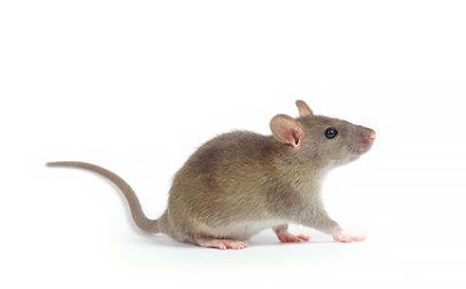
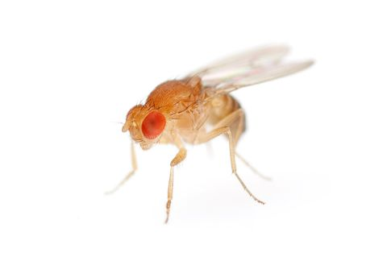
So what about fruit flies?

Slide 28
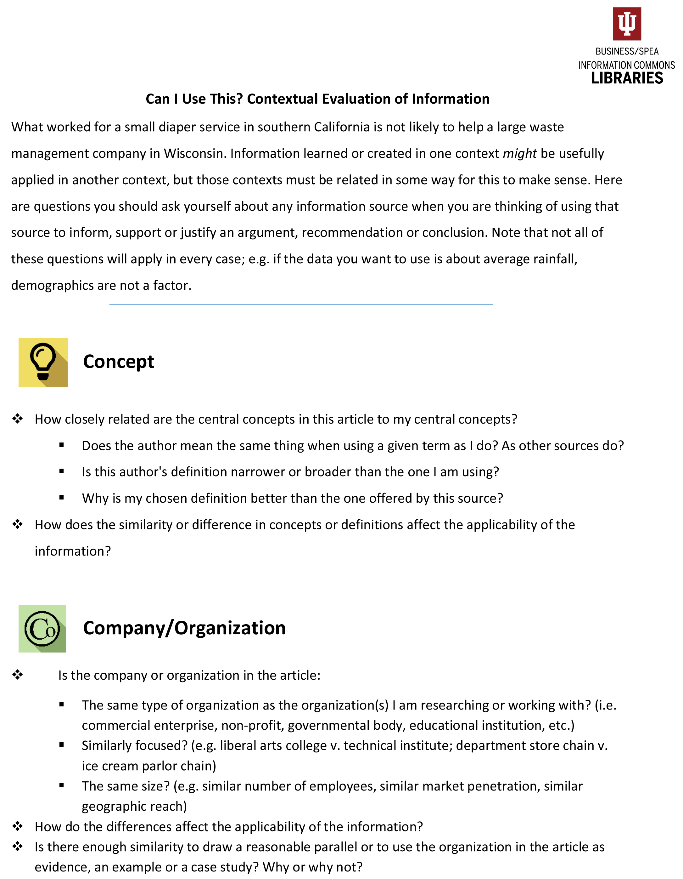
Intervention 2
1 article & contextual evaluation worksheet given to students to work through on their own
Turned in as an annotated PDF
Discussed in class

Slide 29
Intervention 2
Concept
How closely related are the central concepts in this article to my central concepts?
Does the author mean the same thing when using a given term as I do? As other sources do?
Is this author's definition narrower or broader than the one I am using?
Why is my chosen definition better than the one offered by this source?
How does the similarity or difference in concepts or definitions affect the applicability of the information?

Slide 30
Intervention 2
Company
Is the company or organization in the article:
The same type of organization as the organization(s) I am researching or working with? (i.e. commercial enterprise, non-profit, governmental body, educational institution, etc.)
Similarly focused? (e.g. liberal arts college v. technical institute; department store chain v. ice cream parlor chain)
The same size? (e.g. similar number of employees, similar market penetration, similar geographic reach)
How do the differences affect the applicability of the information?
Is there enough similarity to draw a reasonable parallel or to use the organization in the article as evidence, an example or a case study? Why or why not?

Slide 31
Intervention 2
Demographics
Is the article focused on the same group of people I am concerned with?
Same culture? (Keep in mind that culture does not follow country borders; the culture in Vermont is markedly different than the culture in Texas.)
Same language?
Same socio-economic standing?
Same age?
Same education?
Is the data or information in the article as likely to apply to my demographic of interest as the demographic discussed in this source? Why or why not?

Slide 32
Intervention 2
Geography
Is the article focused on the same group of people I am concerned with?
Same culture? (Keep in mind that culture does not follow country borders; the culture in Vermont is markedly different than the culture in Texas.)
Same language?
Same socio-economic standing?
Same age?
Same education?
Is the data or information in the article as likely to apply to my demographic of interest as the demographic discussed in this source? Why or why not?

Slide 33
Intervention 2
1. Click on Tools
5. Highlight text
2. Click on Comment
6. Select arrow tool
3. Select highlighter
7. Click on highlight
8. Type comment
4. Select color
9. Click Post

Slide 34
Intervention 3
1 short article given to students to read on their own
4 hypothetical research scenarios presented
Students worked through each in groups before sharing out and discussing

Slide 35
Alternative Scenarios
In the wake of bad press, you have been hired by a small company to advise on gender parity.
You are writing a newspaper piece on public policy and ethnic minorities.
A university has asked your company to consult as they work to develop and publicize an LGBTQ inclusiveness policy.
As part of an ad campaign for a non-profit, you are researching the attitudes of high school students with regard to diversity .

Slide 36
?

