Slide 1
Combating Digital Polarization:
Teaching Undergraduates Web Literacy Using “Four Moves and a Habit”

Slide 2
WHO ARE WE?

Slide 3
The DigiPo Team
Yan He, MLS, MS, Associate Librarian, Information Literacy Coordinator
Paul Cook, PhD, Associate Professor of English and Director of Writing
Todd Bradley, PhD, Associate Professor of Political Science
Polly Boruff-Jones, MLS, MPA, Librarian, Dean of the Library

Slide 4
Agenda for today
IU Kokomo Overview
AASCU ADP DigiPo Project
Introducing “Four Moves and One Habit”
Implementation
Assessment
Future plans

Slide 5
IU Kokomo overview
Public, four-year university
Located in Kokomo, Indiana, a city of 50,000 an hour north of Indianapolis
Economy historically dependent on agriculture and automobile manufacturing
Opened its doors in 1932 as “Kokomo Junior College” and became part of the IU system in 1945
Many incoming students are first-generation college students
Approximately 130 full-time faculty offer courses to nearly 4,000 students

Slide 6
Digi what?
AASCU’s ADP DigiPo
American Association of State Colleges & Universities, American Democracy Project, Digital Polarization Initiative
Indiana University Kokomo | San Jose State University
Black Hills State University | Texas A&M International University
Georgia College & State University | University of North Carolina at Charlotte
Metropolitan State University of Denver | Washington State University Vancouver

Slide 7
National initiative
DigiPo training:
workshops
webinars
online discussions
Course module
curriculum repository
Canvas course
Common assessment

Slide 8
Campus planning
Campus co-liaisons
Campus Steering Committee
Enthusiastic faculty
Clear expectations for participating faculty
Co-curricular activities in future

Slide 9
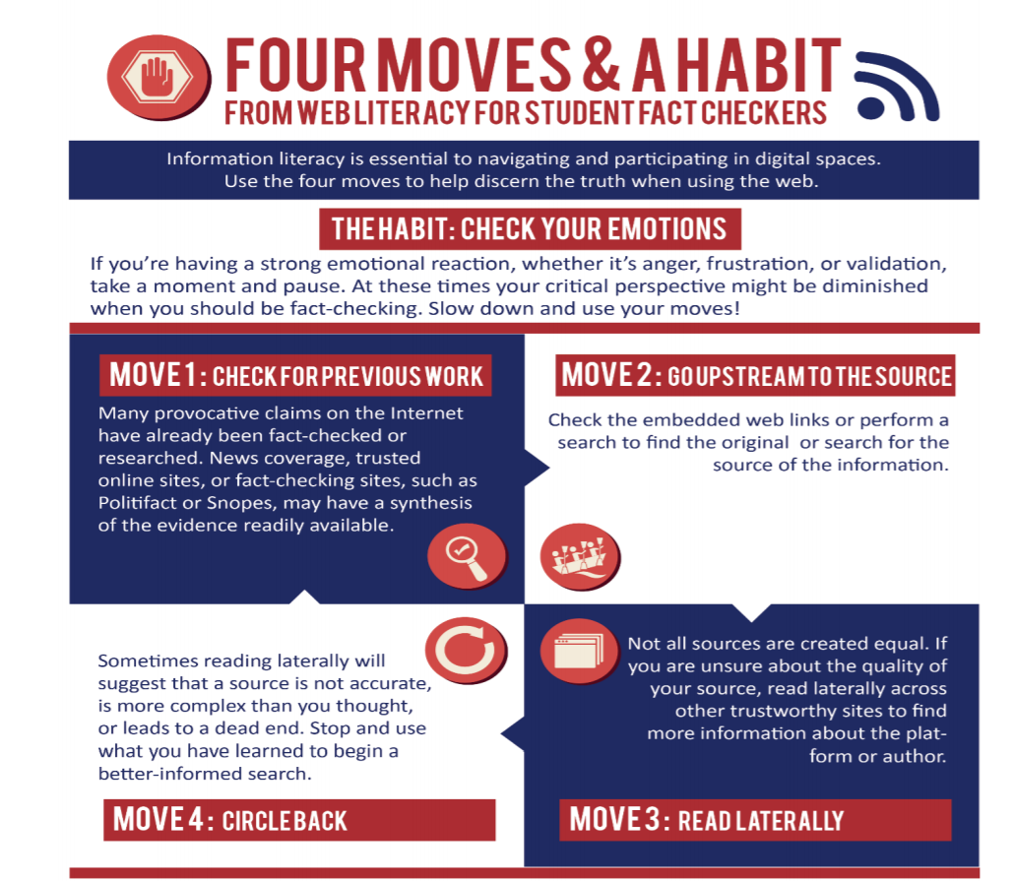

Slide 10
Check for previous work
News Coverage
Google News
Trusted online sites or sources
Education/Government Websites
Reputable Fact-Checking Sites
Factcheck.org
NPR Fact-Check
Politifact
Snopes
Washington Post Fact Checker

Slide 11
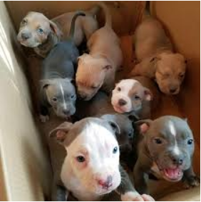
Go Upstream to the Source
Follow links to the source
Use reverse image search to source a photo
Text reads: been clearing out craigslist in my area. It’s rightfully illegal to own pitbulls in Ontario so when I drop them off at the pound they’ll take care of the rest.
Is this for real?

Slide 12
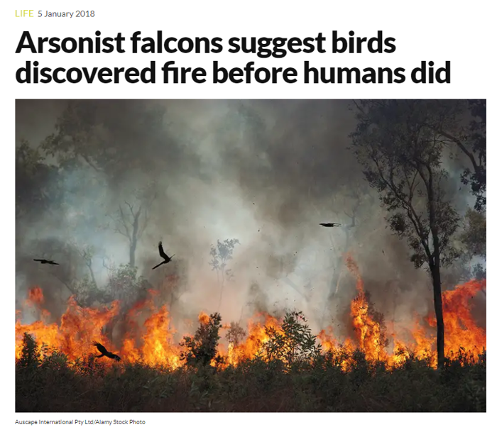
Read laterally
Check Wikipedia background on organization
If Wikipedia coverage doesn’t exist, check for Google News coverage of the organization
A recent article from New Scientist:
Is the magazine a credible one?
Any news items by other media?
Any cited sources in the article?
https://www.newscientist.com/article/2157887-arsonist-falcons-suggest-birds-discovered-fire-before-humans-did/

Slide 14
Implementation
Freshman Learning Community
Freshman Seminar in Sciences and Mathematics
Student Success Seminars
KEY Summer Institute
First-Year Writing (ENG-W 131)
Political Science

Slide 15
Activities
Online Information verification videos and lesson scripts from DigiPo coordinators
Four moves blog: https://fourmoves.blog
Michael Caufield's blog: https://hapgood.us
Hands-on exercises
Gamification
Group activities

Slide 16
Contemporizing our efforts
Tiered information literacy program
Traditional web evaluation curriculum
“Four Moves and a Habit” fact-checking technique
Not replacing what we have done traditionally, but enhancing what we do

Slide 17
Assessment
Assessment questions and rubric were designed by the national DigiPo coordinators
Pre-test and post-test measured students’ ability to verify, contextualize, and reason about information they found online
Students who took the A version as pre-test used B version in the post-test and vice versa

Slide 18
Assessment question categories
Photographic evidence
Sourcing evidence
Clickbait science and medical disinformation
Fake news

Slide 19
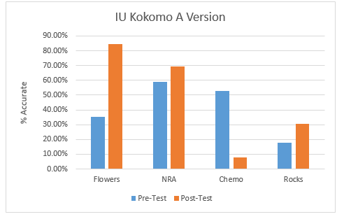
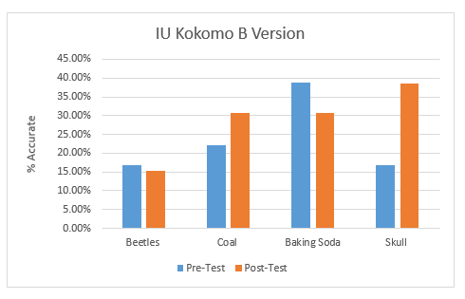
Results

Slide 20
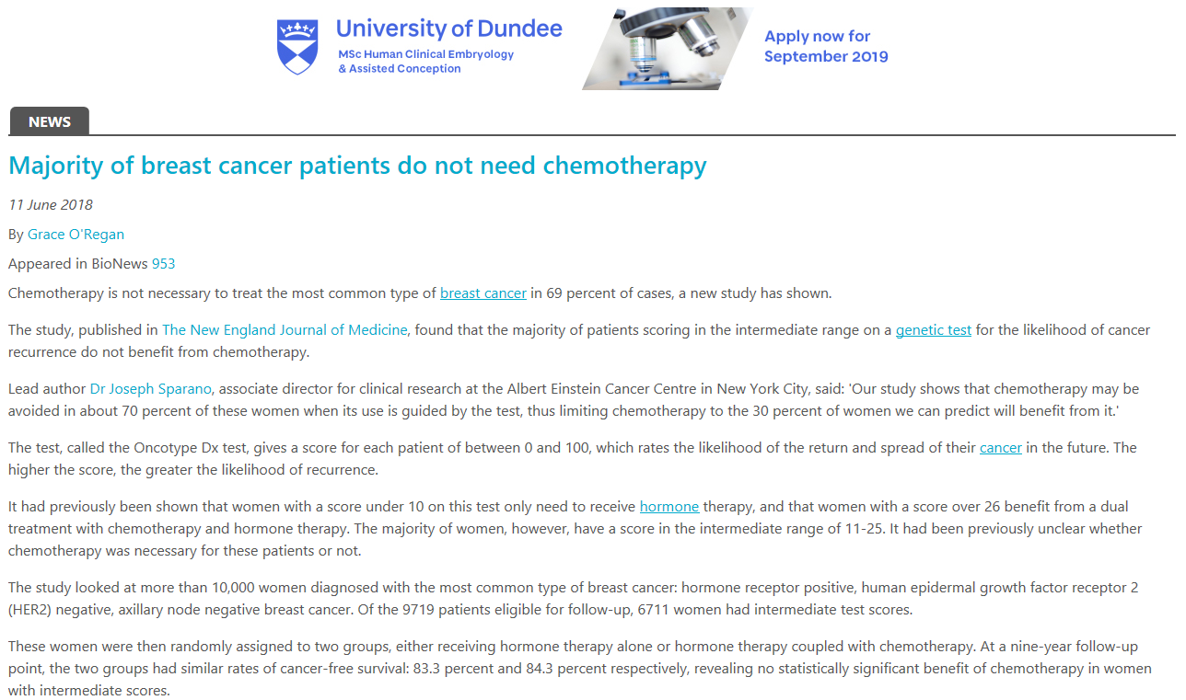
Chemo Question
It claims a new study shows that the majority of breast cancer patients do not need chemotherapy
Rate the trustworthy level from very low, low, medium, high, very high, and unsure.

Slide 21
Future Plans
Continue to implement DigiPo in Student Success Seminar, Freshman Seminar in Sciences and Mathematics, and Political Science classes
Integrate the “four moves and one habit” technique into the web evaluation curriculum for all English Composition classes
Develop the qualitative assessment method

Slide 22
Partnership
Partner with the community college to pilot DigiPo and compare and contrast results
Contact us for details and we can put you in touch with the DigiPo coordinators

Slide 23
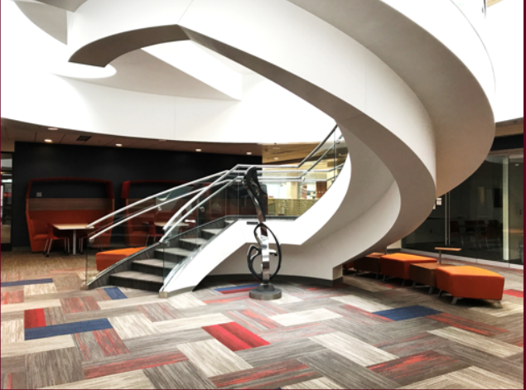
Thank you! Questions?
Contact:
Polly Boruff-Jones, pboruffj@iuk.edu
Yan He, yh4@iuk.edu

