Slide 1
Using Wikipedia to Explore Critical Information Literacy in a Credit Bearing Course
Amanda Foster-Kaufman
Wake Forest University
fosterab@wfu.edu

Slide 2
What Is Critical Information Literacy?
Critical Information Literacy (which grew out of Critical Pedagogy) explores how information is used as a structure of power and oppression, and how these power structures can be resisted and changed

Slide 3
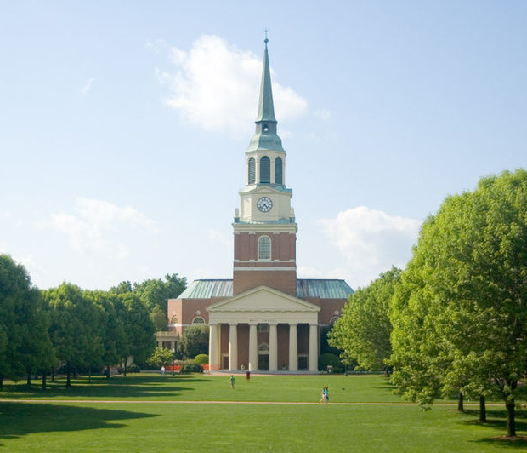
Wake Forest University
Winston Salem, NC
Private, Small Liberal Arts College (SLAC)
5,000 Undergraduates
Majority of students are full time/traditional
Total cost of attendance: $69,192
45% increase in ethnic diversity in the last 6 years

Slide 4
LIB 100 at WFU
LIB100: Academic Research and Information Issues
Taught since 2003; healthy enrollment
24~ sections/year
Elective credit
15 student cap

Slide 5
LIB 100 at WFU, cont’d
Shared learning outcomes
Freedom to choose instructional method
Historically, LIB 100 has focused on teaching library skills and exploring the research process
Most common assignment is the annotated bibliography

Slide 6
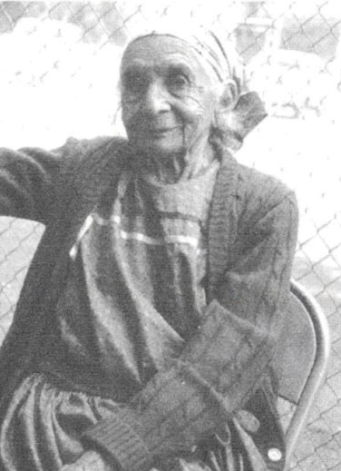
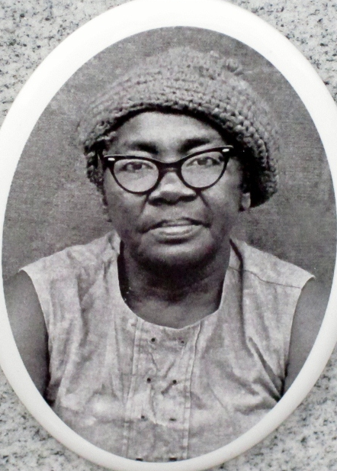
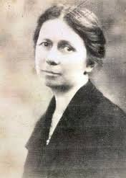
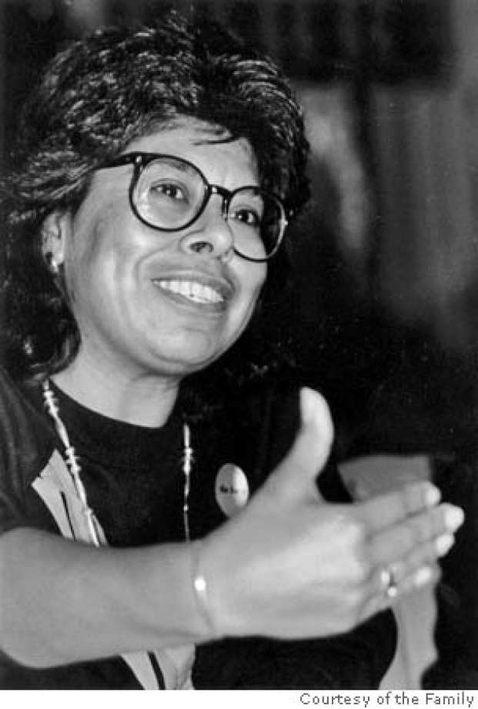
What Was The Wikipedia Project?
Simon Green Atkins
Maggie Axe Wachacha
Mary Jane Manigault
Dr. Mary T. Martin Sloop
Jessica Govea Thorbourne

Slide 7
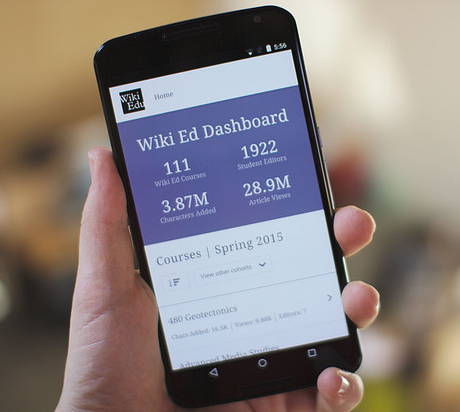
Wikipedia Logistics
All college courses conducting Wikipedia-related projects are encouraged to sign up with WikiEdu
WikiEdu assigns you a liaison, offers training modules, a course dashboard, etc…

Slide 8
LIB 100 Wikipedia Project Timeline
Week 1: Wikipedia Article Critique; Wikipedia Training
Week 2: Select Biographical Subject
Week 3: Research
Week 4: First Draft
Week 5-6: Second Draft; Peer Reviews
Week 7: Publish Article

Slide 9
Four Critical Questions
Who Writes History?
Who Provides Access to Information?
Who Has Access to Information?
How Do I Write History?

Slide 10
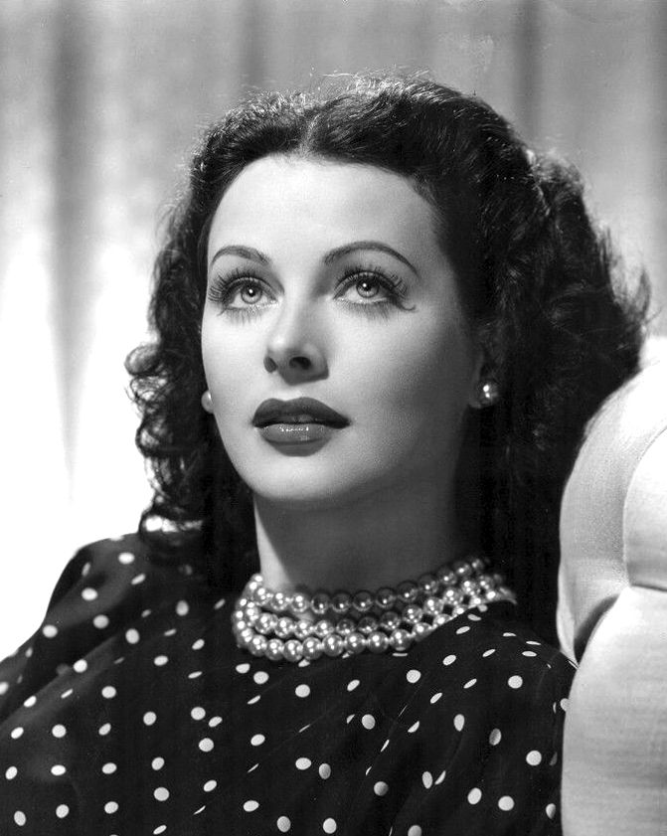
Who Writes History?
Week 1: Class Discussion: Systemic Bias on Wikipedia

Slide 11
Who Writes History?
”1,000 Articles Every Language of Wikipedia Should Have”

Slide 12
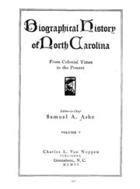
Who Writes History?
Week 1: Class Discussion
How Is History Written?
Who Does the Writing?

Slide 13
Who Provides Access to Information?
Weeks 2-4: Class Discussion and/or Course Blog:
Root Question: How do information gatekeepers intentionally (and/or unintentionally) negatively impact marginalized groups?

Slide 14
Who Provides Access to Information?
Weeks 2: Class Discussion and/or Blog Post/Individual Reflection:
Wikipedia Guidelines/Policies
“Neutral Point of View”
Notability/“Secondary Sources” Guideline

Slide 15
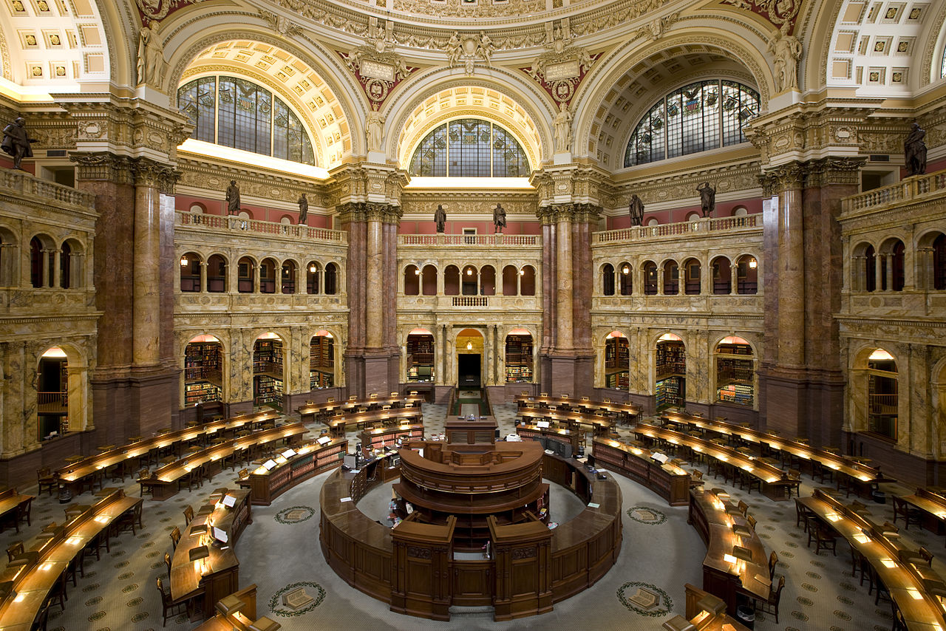
Who Provides Access to Information?
Throughout: Class Discussion and/or blogs:
Internet Searching/Google
Organization of Information/Subject Headings

Slide 16
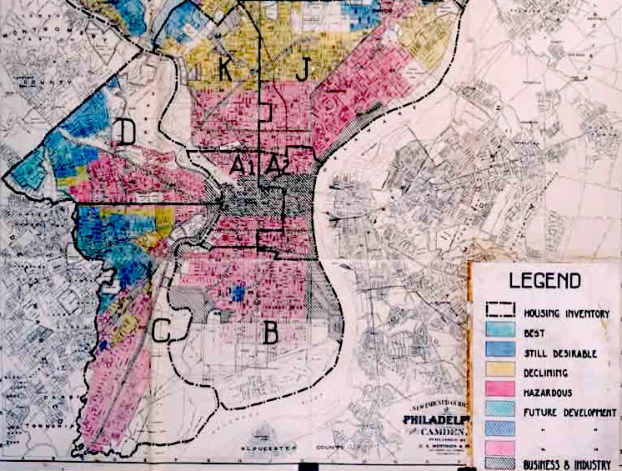
Who Has Access to Information?
Weeks 4-5 Class Discussion and/or blog post:
Is Wikipedia Free?
Information Privilege

Slide 17
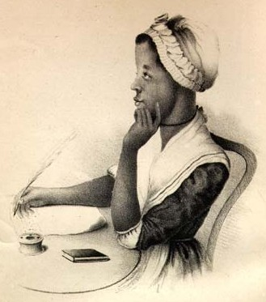
How Do I Write History?
Weeks 3-7: Class Discussion:
Guide: Writing About Women
Other Considerations
Reinforced Via Draft Feedback

Slide 18
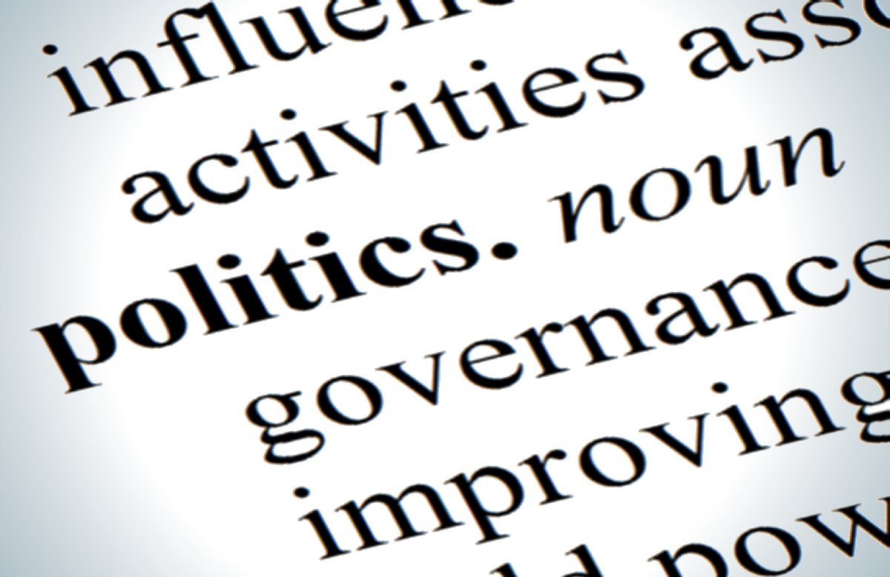
Considerations: Getting Political
Critical Information Literacy is Inherently Political
Do Consider Your Own Environment/Situation
Ensuring the Classroom Remains a ”Safe Space”

Slide 19
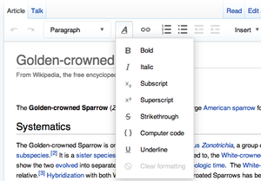
Considerations: Tech Savviness
You don’t need to be as tech savvy as you think!
Wikipedia has a WYSIWYG editor
However, *some* things require you to use the back-end editor

Slide 20
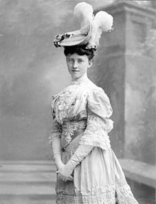
Considerations: Finding Topics
Tips for Finding Biographical Subjects
Start Local! Look in your own backyard
Encyclopedias! Many encyclopedias focus on marginalized groups

Slide 21
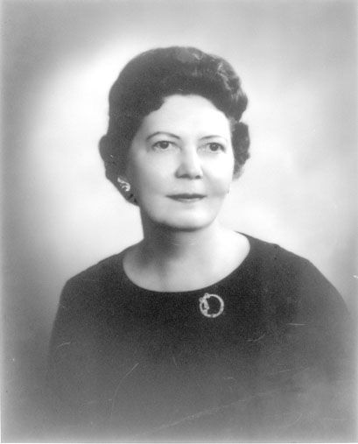
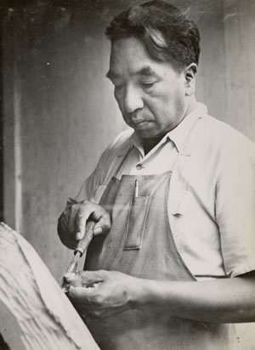
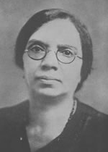
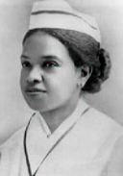
Questions?
Joseph Winthrop Holley
Dr. Hilla Sheriff
Goingback Chiltoskey
Annie Wealthy Holland
Anna DeCosta Banks

Slide 22
Image Credits
Wake Forest: https://commons.wikimedia.org/wiki/File:UpperQuad_ACB.jpg
Google Glass photo: Ken Bennett, WFU photograher
WikiEdu: https://commons.wikimedia.org/wiki/File:Dashboard.wikiedu.org_on_a_large_Android_phone,_2015-04-16.jpg
Hedy Lamer: https://commons.wikimedia.org/wiki/File:Hedy_Lamarr_Publicity_Photo_for_The_Heavenly_Body_1944.jpg
North Carolina History Book: https://archive.org/details/biographicalhis03ashegoog
Wikipedia “Scales” https://en.wikipedia.org/wiki/Wikipedia:Neutral_point_of_view
Library of Congress https://commons.wikimedia.org/wiki/File:LOC_Main_Reading_Room_Highsmith.jpg
Digital Redlining: https://commons.wikimedia.org/wiki/File:Home_Owners%27_Loan_Corporation_Philadelphia_redlining_map.jpg
Phyllis Wheatley: https://commons.wikimedia.org/wiki/File:Phillis_Wheatley_frontispiece.jpg
Visual Editor: https://en.wikipedia.org/wiki/VisualEditor
Politics image: http://thebluediamondgallery.com/p/politics.html
Katharine Smith Reynolds: https://en.wikipedia.org/wiki/Katharine_Smith_Reynolds

